Slide 1


ML FOR MARCH MADNESS FORECASTING
BY. ATHANASIOS TASSIADAMIS
MENTOR: DR. LA PLANTE

Slide 2
BACKGROUND
Every March, the NCAA hosts its annual men’s and women’s playoff basketball tournament, commonly known as “March Madness.” It has become a tradition for sports enthusiasts and analysts to create brackets in an attempt to predict the outcomes of these games. In this presentation, we explore the effectiveness of using regular season data and various machine learning techniques to predict the outcomes of NCAA men’s tournament games.

Slide 3
RESEARCH QUESTION(S)
Can machine learning models outperform a simple seed-based baseline in predicting NCAA men's tournament game outcomes?
How can we scale and adjust model features to better suit the context of the NCAA tournament and improve predictive accuracy?

Slide 4
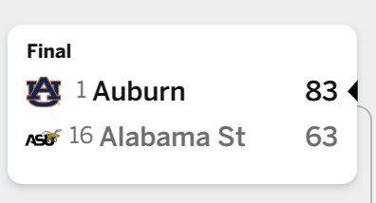
ESTABLISHING A BASELINE
What would our accuracy be (correct predictions/total predictions) if we picked the higher seed to win every single time.
Our findings indicate that form the 2003-2024 season if you were to pick the higher seed to win every game and gave a 50/50 split for teams with the same seed the accuracy would be ~69.68%.
If our models can predict > 69.68% accuracy it would indicate using regular season data can boost us past the baseline.

Slide 5
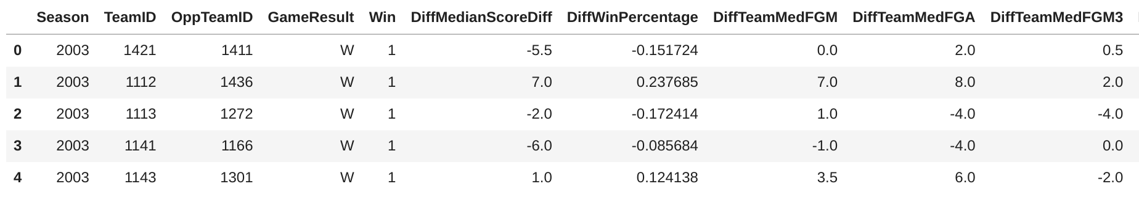
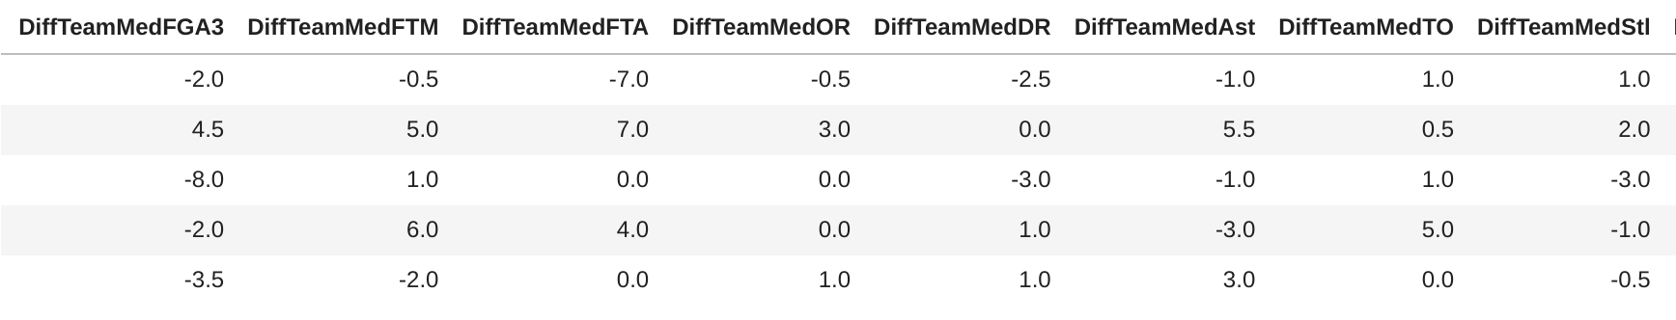
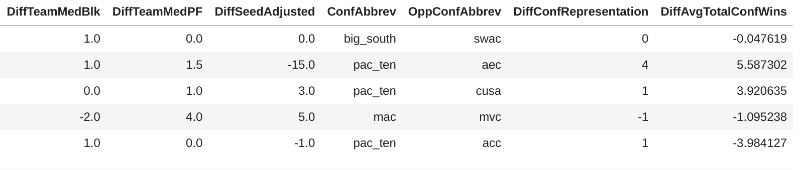
Training Dataset After Processing Sample #1

Slide 6
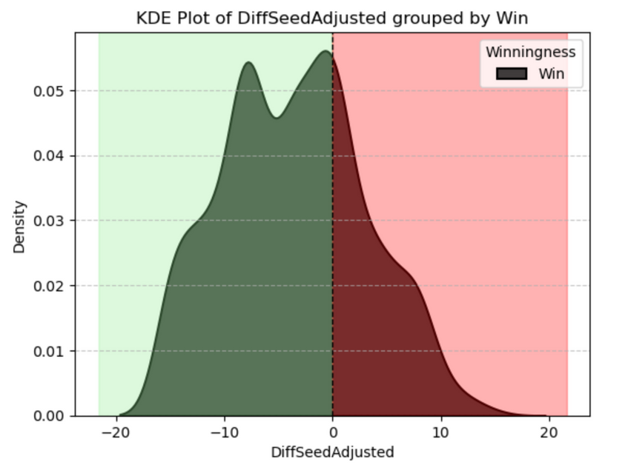
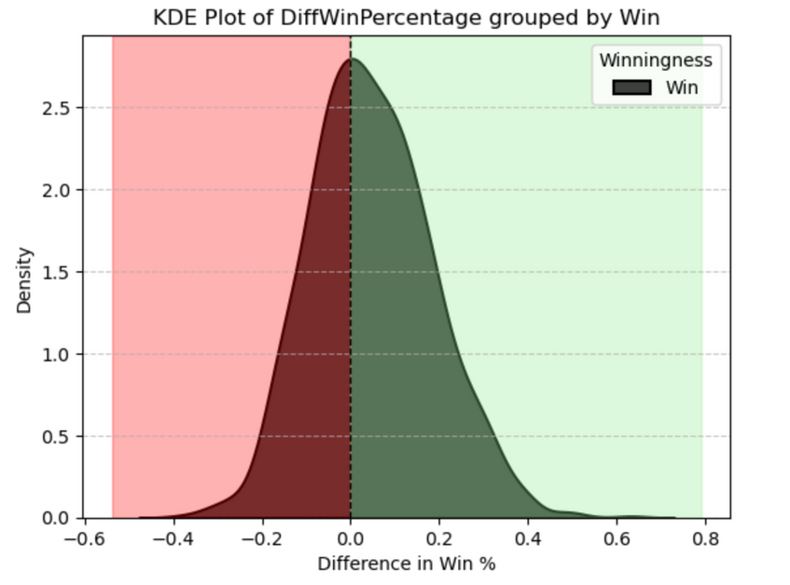
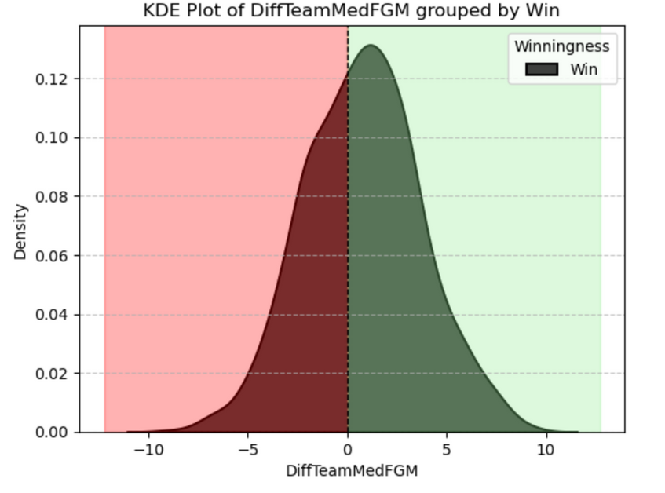
Feature Densities Visualized

Slide 7
CONTEXTUAL ISSUES WITH USING MEDIAN STATS & REGULAR SEASON STATS
Don’t account for hot or cold streaks throughout the season.
They assume that two teams will always play at their median case in a tournament match up (we know this to not be true).
Conference strength isn’t accounted for. A team that averages 100 points in a weaker conference isn’t necessarily stronger than a team that averages 80 in a very strong conference.
Doesn’t account for the favorite-longshot bias (overestimating the odds of an underdog winning) as when stronger teams are winning they will take out their best players, which skews their stats.
Regular season data falls short of capturing tournament specific events (i.e. injuries, hot and cold streaks, match up difficulty, tournament specific performance, etc.)

Slide 8
HOW DO WE ADJUST OUR REGULAR SEASON DATA TO REFLECT DIFFERENCES IN CONFERENCE STRENGTH?

Slide 9
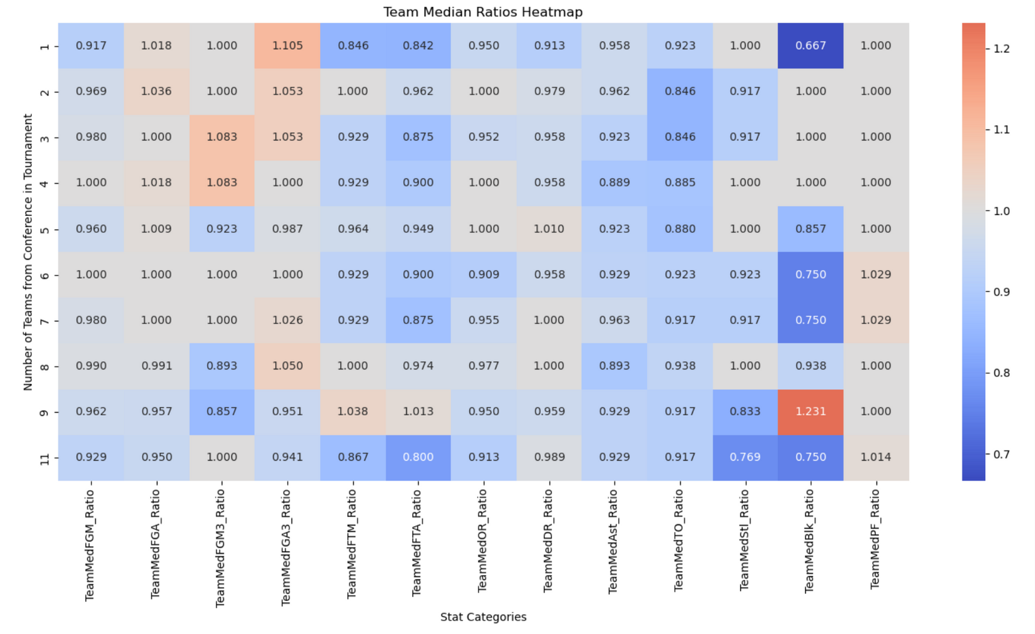
AN EMPIRICAL APPROACH TO ADJUSTING STATS TO CONFERENCE STRENGTH (WEAK ATTEMPT 1) (UNUSED)

Slide 10
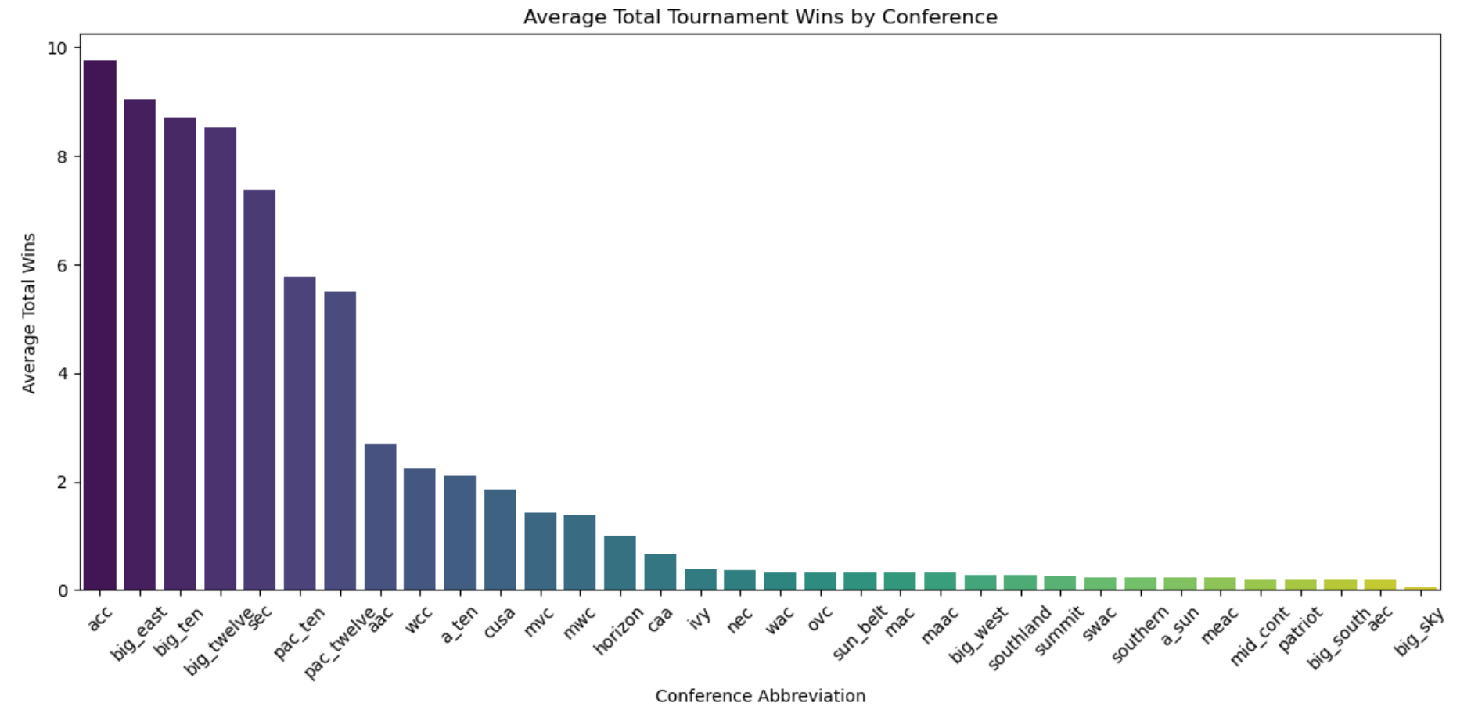
AN EMPIRICAL APPROACH TO ADJUSTING STATS TO CONFERENCE STRENGTH (STRONGER) (USED)

Slide 11
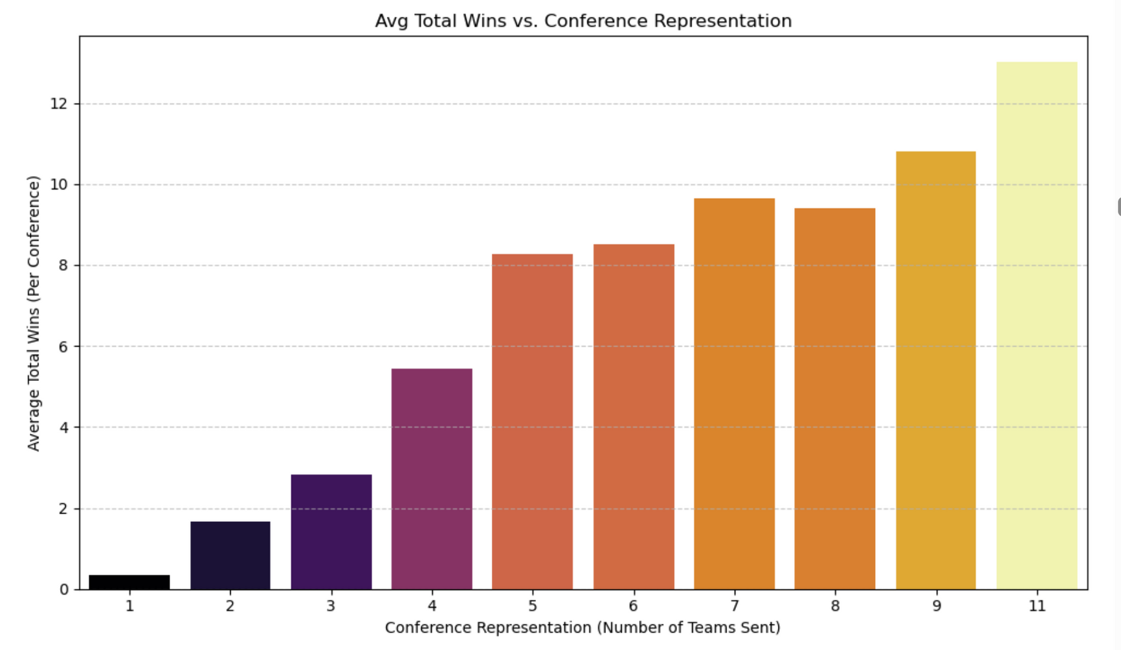
AN EMPIRICAL APPROACH TO ADJUSTING STATS TO CONFERENCE STRENGTH (STRONGER) (USED)

Slide 12
Final Training Dataset Sample

Slide 13
MODEL OUTCOMES WITH ONLY REGULAR SEASON DIFFERENTIALS(#1)

Slide 14
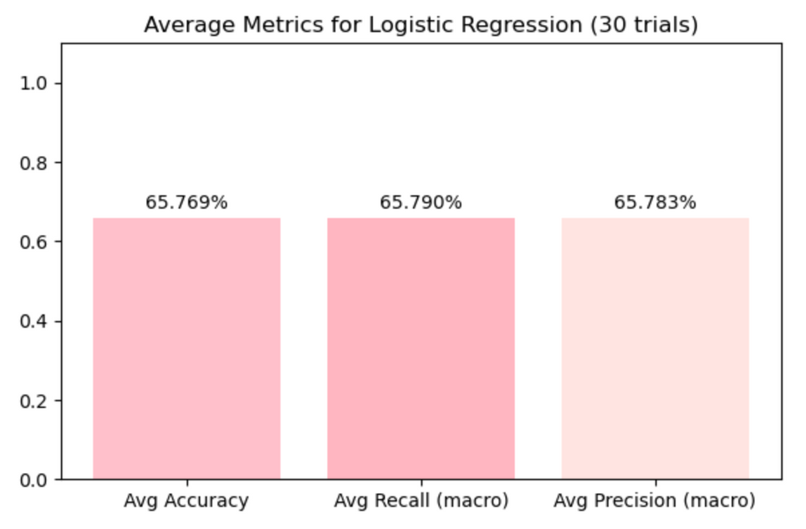
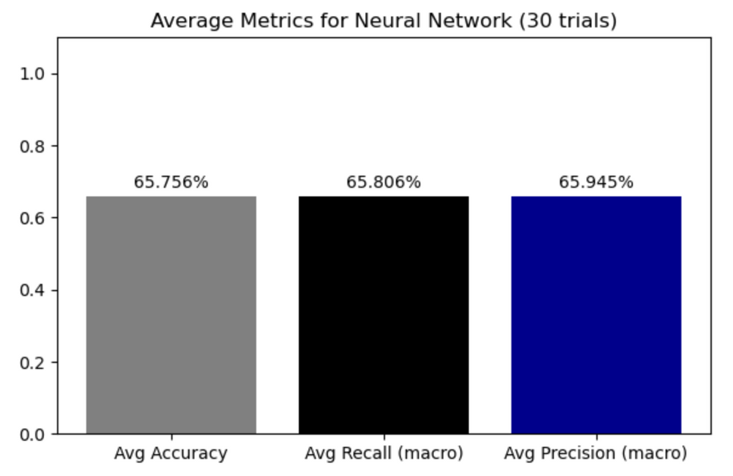
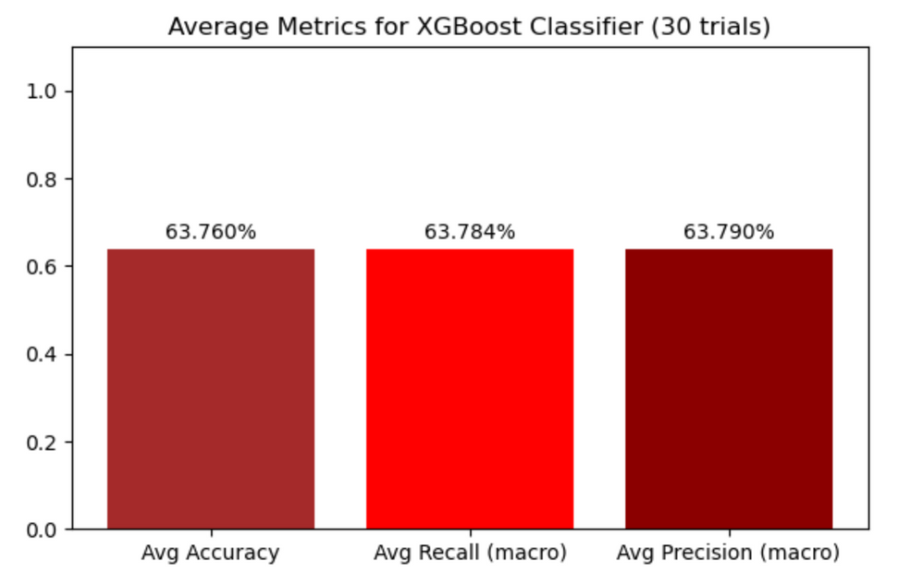
MODEL RESULTS (#1)

Slide 15
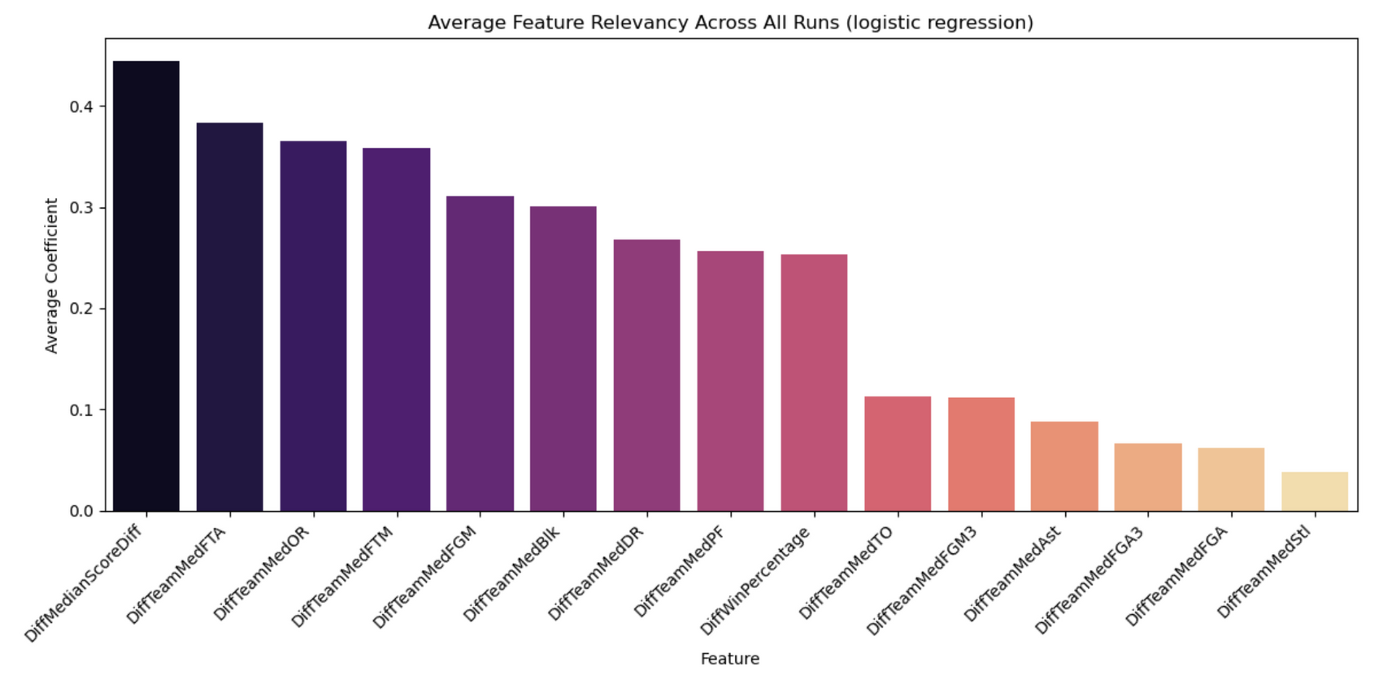
MODEL FEATURE RELEVANCY (#1)

Slide 16
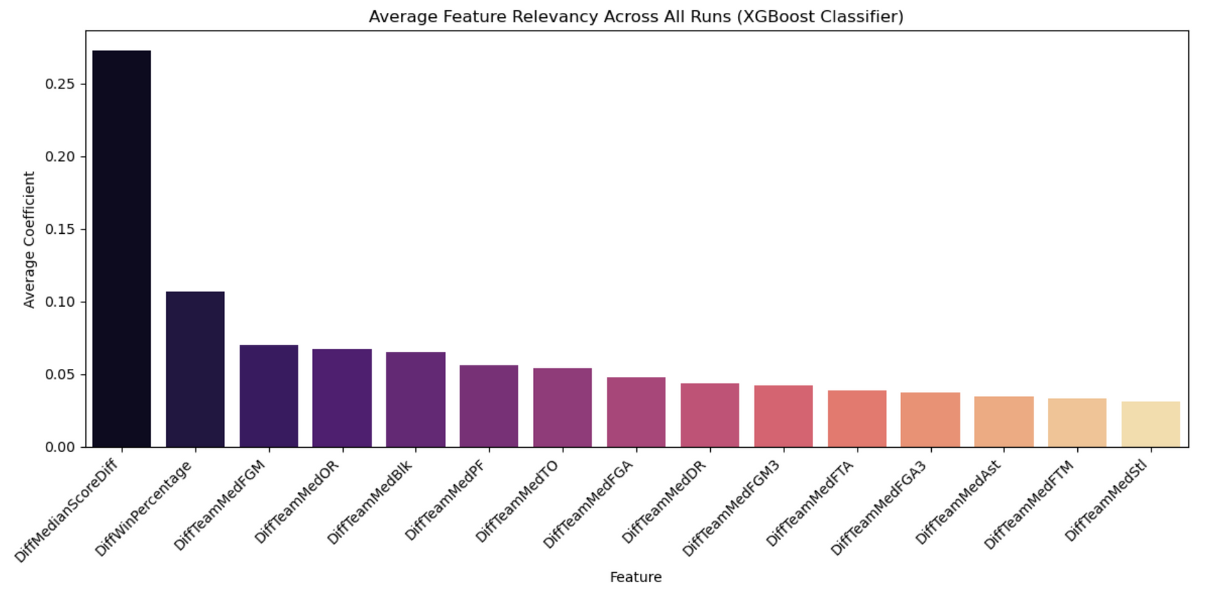
MODEL FEATURE RELEVANCY (#1)

Slide 17
MODEL OUTCOMES WITH CONFERENCE STRENGTH ADJUSTMENTS (#2)

Slide 18
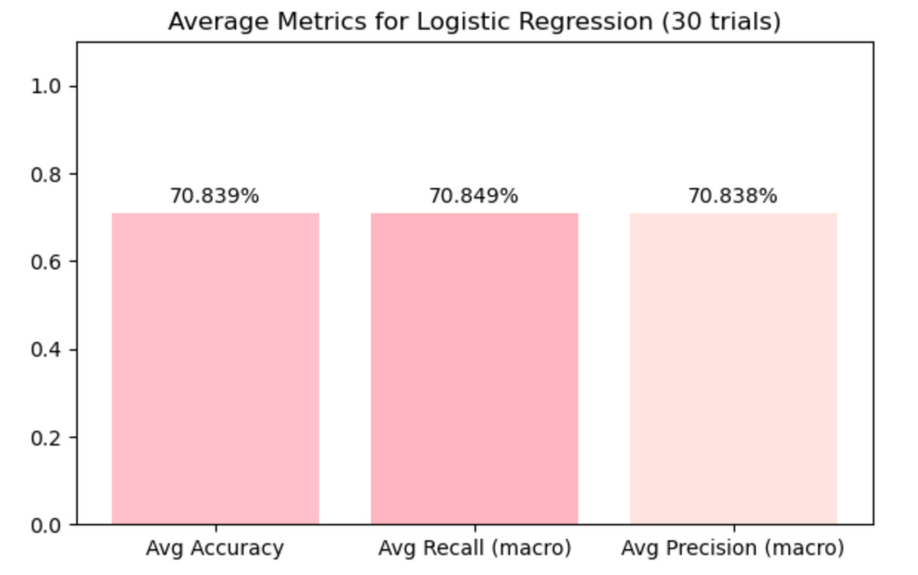
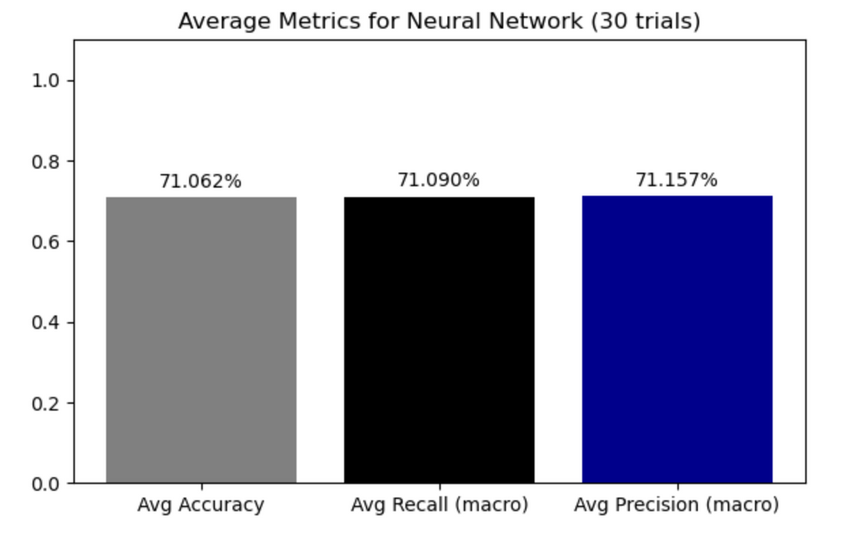
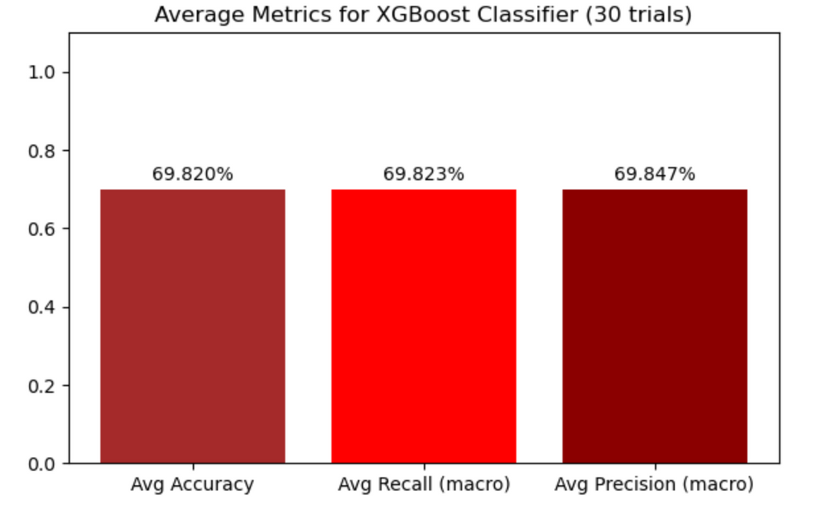
MODEL RESULTS (#2)

Slide 19
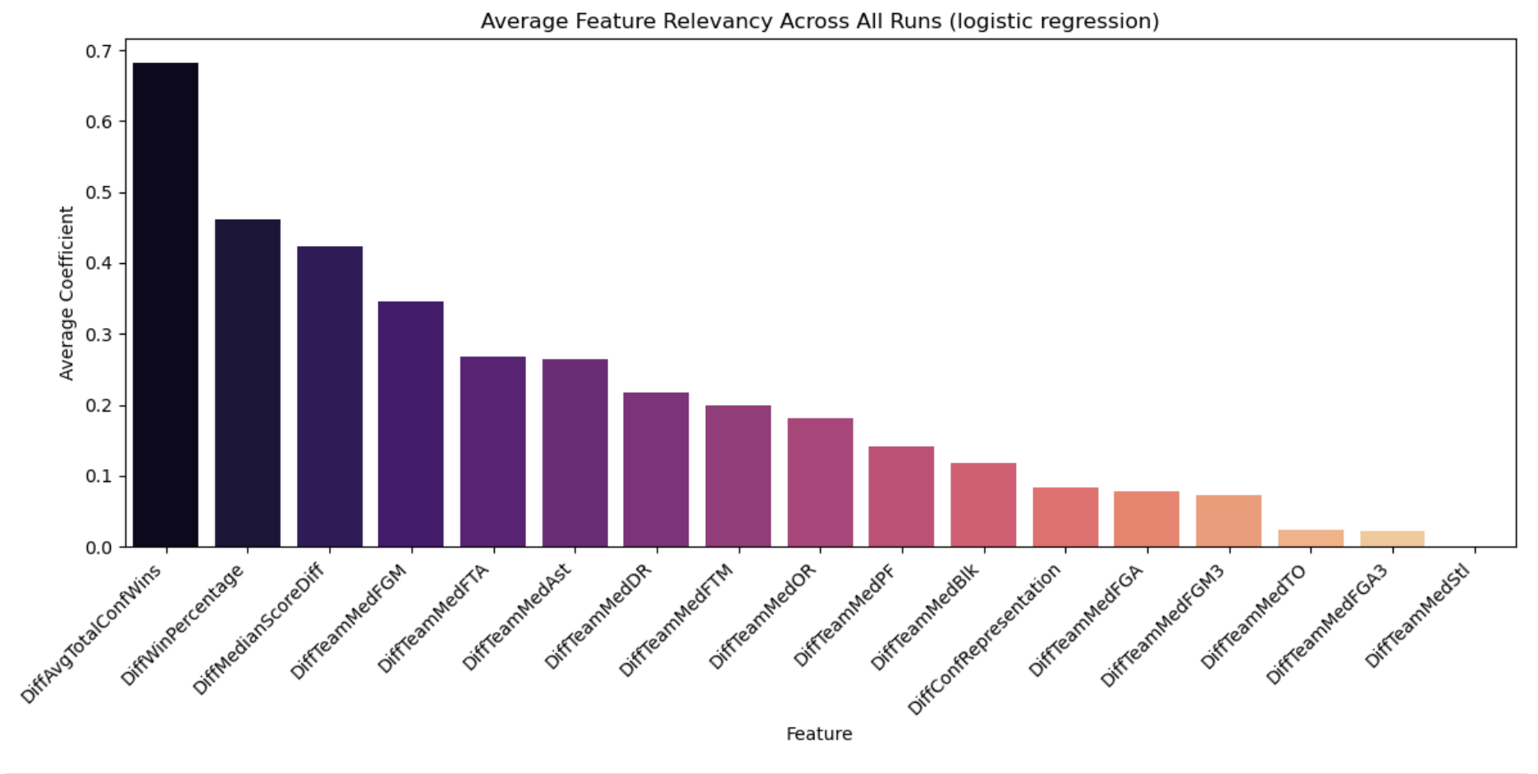
MODEL FEATURE RELEVANCY (#2)

Slide 20
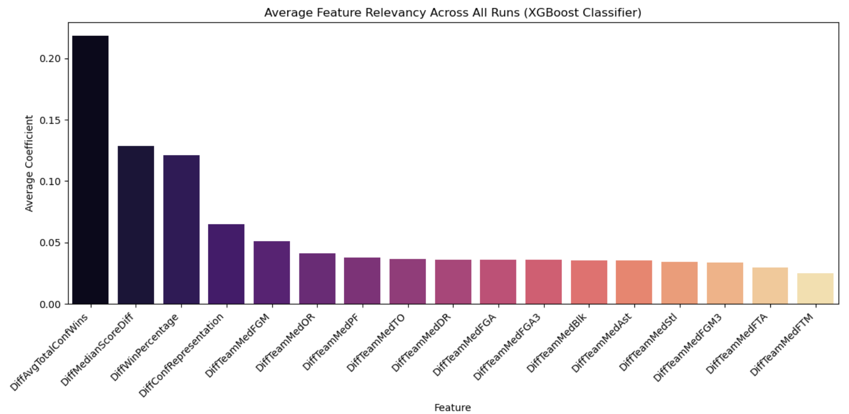
MODEL FEATURE RELEVANCY (#2)

Slide 21
MODEL OUTCOMES WITH ALL FEATURES (INCLUDING SEEDING)(#3)

Slide 22

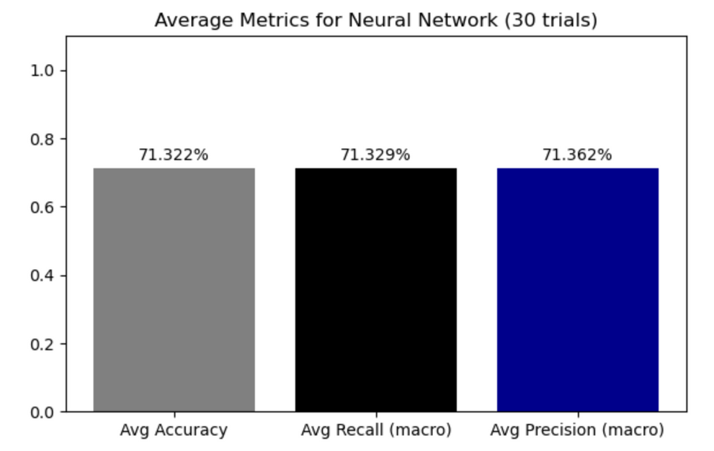
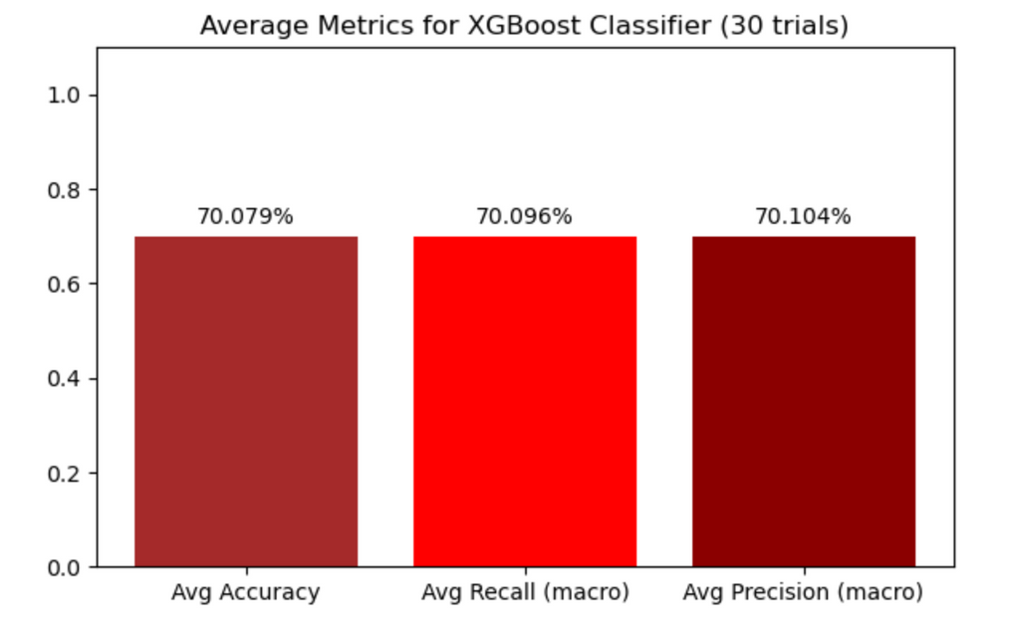
MODEL RESULTS (#3)

Slide 23
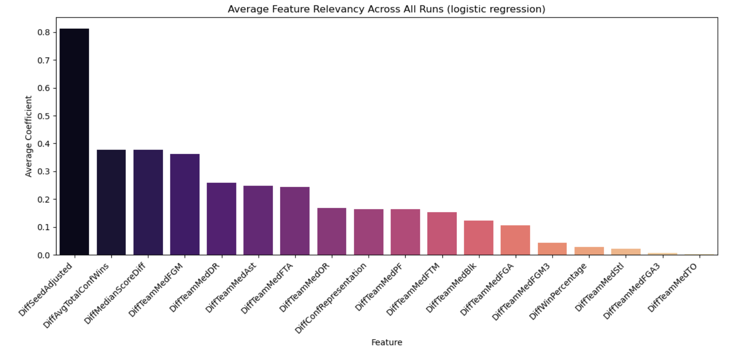
MODEL FEATURE RELEVANCY (#3)

Slide 24
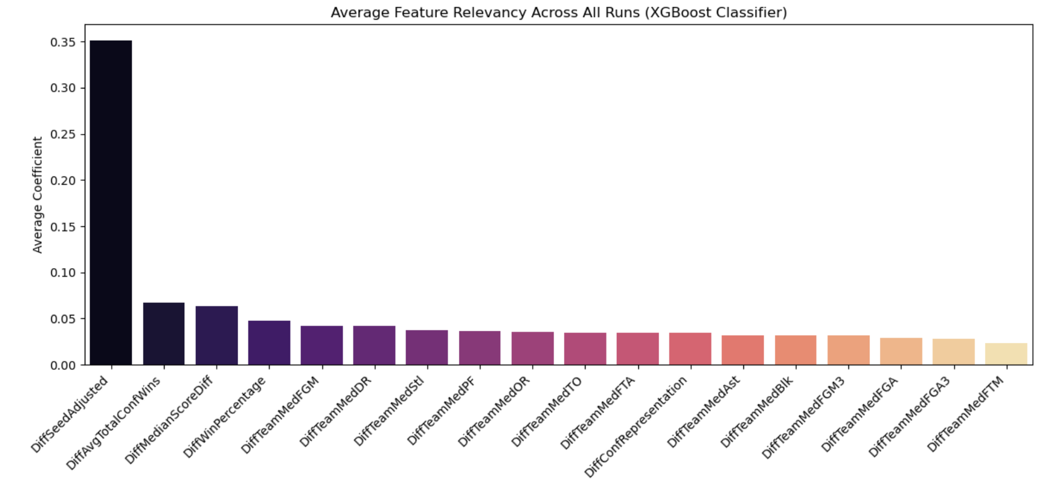
MODEL FEATURE RELEVANCY (#3)

Slide 25
KEY TAKEAWAYS
1.) Using regular season data with adjusted conference strength features leads to a marginal increase in predictive performance compared to the baseline ~71.50% > ~69.68%
2.) Team seed is still the largest indicator of whether or not a team will win a tournament game.
3.) There are many external factors that influence regular-season data making it difficult to make predictions with. Some modern attempts to combat these factors have been models that focus more on tournament momentum and elo-based regular season models.

